Slide 1

CSPB 3308 Team 3 Final Presentation
Cassandra Cohen
Ronald Durham
Grant Fairbairn
Jordan Sims

Slide 2
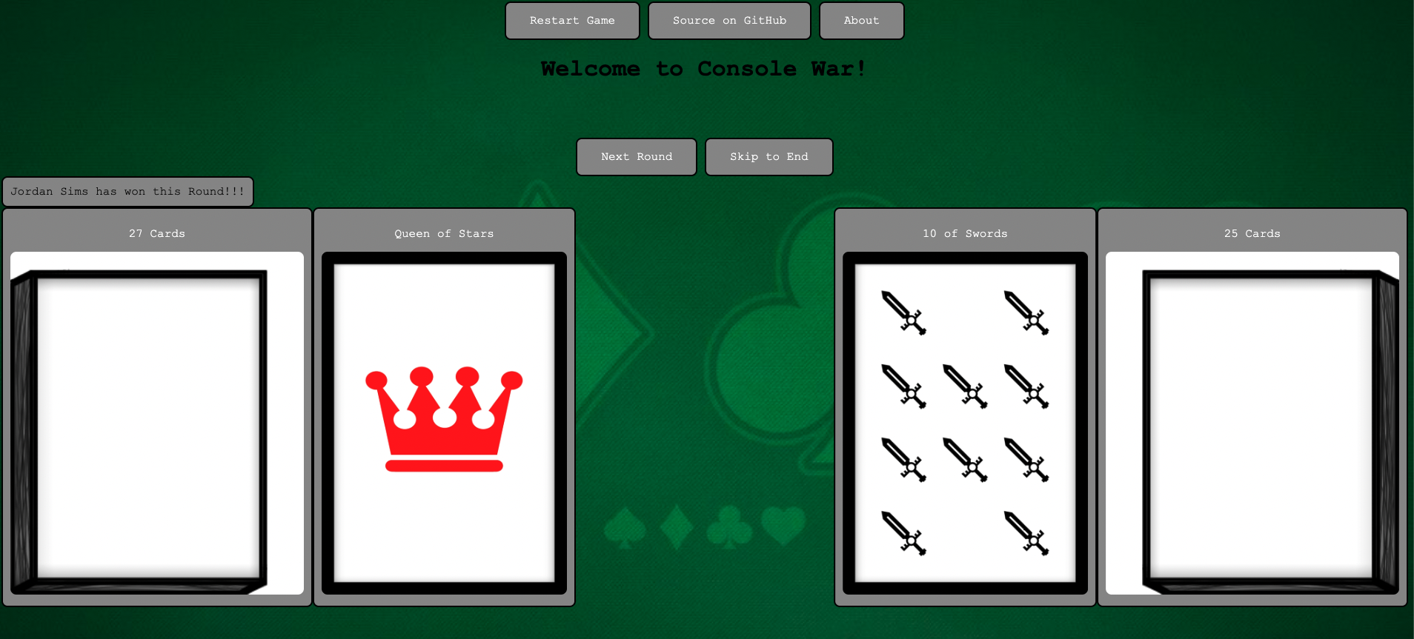
Project goal
The goal of this project was to create an online, graphical version of “War” – the classic card game

Slide 3


Front End Tools

Slide 4
HTML/CSS

Slide 5
Heroku

Slide 6

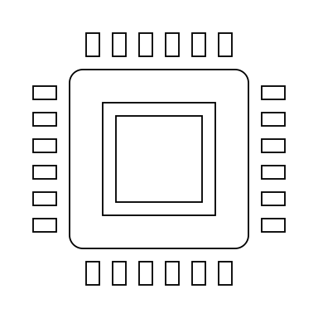
Back End Tools

Slide 7

JavaScript
The JavaScript language was used for the back end of the project
This was chosen for its ease of use with HTML and CSS
While it was a challenge to have to learn JavaScript for this project, it proved to be the right call

Slide 8


IntelliJ IDEA and node.js
For programming the back-end in JavaScript, IntelliJ IDEA was used as the primary IDE
Beyond scripting, IntelliJ was additionally used for documentation of the code as well as debugging the JavaScript
For documentation, the code was commented out to explain to future and present developers and teams
For debugging, the Node.js runtime environment was used in conjunction with the IntelliJ debugger to run the JavaScript code and debug it

Slide 9

Art tools

Slide 10
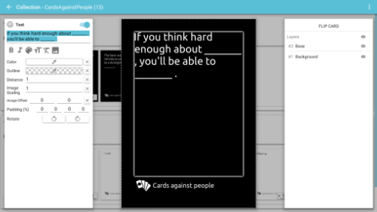
Card Creator
For creating the images of the cards used in the game, a program called Card Creator was used.
Card Creator is designed for use in creating card games or tabletop games, and can create cards and tokens in a variety of standard shapes.
We chose to use a nonstandard set of card suits to fit the icons available through Card Creator.

Slide 11
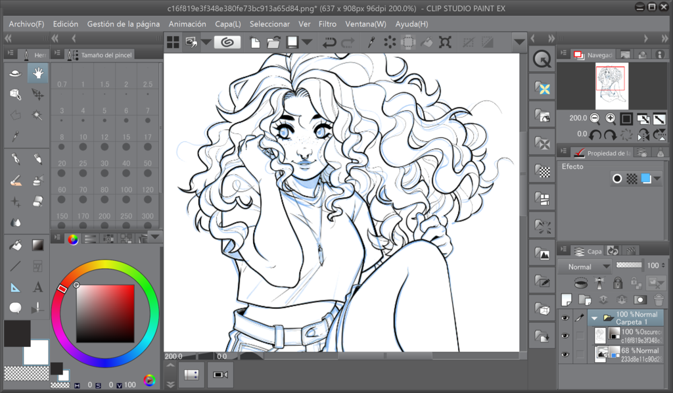
Clip Studio Paint
Clip Studio Paint is an extremely versatile art program that can be used for a wide variety of purposes.
We used it to create the images for the decks themselves, in several sizes.
This allowed us to have the decks change size through a game as cards are divided between them.

Slide 12
Additional Tools Used

Slide 13

Version Control
We used GitHub’s browser platform as well as GitHub Desktop for version control
Reasons we chose GitHub
Ease of Use
Quick updates for rest of team
Ability to work on code independently
Branching capabilities to try different methods of fixing the same problem simultaneously
Project Repository: https://github.com/rodu4835/CSPB_3308_Team_3

Slide 14

Agile Development and communication
We began the semester using standard Scrum method, with standup meetings and Jordan Sims acting as Scrum Master
With four team members in four time zones, we realized early on that we were more productive having continual discussion via text messaging in Discord
We created a channel for Team 3 and discussed the project regularly in that format
We also accumulated checklist items that the members would volunteer to take on and report progress via the Discord channel
We held “in-person“ video meetings as needed to promote progress and assess project goals
Discord channel: https://discord.gg/dmgKnM5DdA

Slide 15
Other Tools Learned in 3308
We initially thought about using Flask in combination with Python
We choose, however, to use JavaScript and HTML/CSS instead after reaching those portions of the course
We did not include a database for this project because, as constituted, the game did not store data
If we were to continue building the game out and create additional features like a leaderboard, we could use SQL

Slide 16
Design Challenges

Slide 17
Challenges and changes
Building the Plane While Flying It
The team had experience with Python coming into the course, but none with JavaScript
We initially developed the game and its features in Python, anticipating that we would use Flask for the front-end
Upon reaching the JavaScript portion of the course, we determined that we could integrate HTML/CSS with JavaScript in a cleaner way
Translating the existing Python code into JavaScript was time-consuming, and some features that were useful in Python but less so in JavaScript fell away
Coordinating Efforts
Coordinating meetings across four different time zones was challenging and led the team to modify its Scrum approach to rely more on messaging in Discord to drive the project forward
Team members had different levels of comfort with various tools (HTML/CSS and Heroku in particular)

Slide 18
Project demonstration

Slide 19
[embed video demo?]

